Slide 1
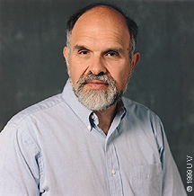
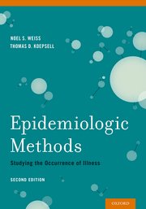
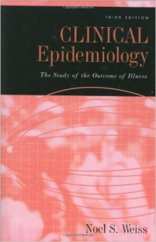
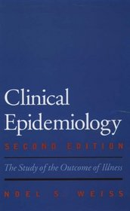
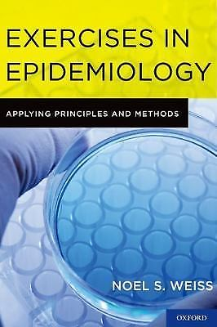
热烈欢迎美国华盛顿大学流行病学教授Prof. Noel S. Weiss来我院参加Global Health MPH《Epidemiology》英文授课
Noel S. Weiss, MD, DrPH, has been a faculty member at the University of Washington and at the Fred Hutchinson Cancer Research Center since 1973. His research has been in the areas of cancer epidemiology and clinical epidemiology. He has authored or co-authored more than 600 publications, including four books. At the University of Washington he has received awards for teaching and mentoring, and in 2011was selected by the Congress of Epidemiology as the First Winner of the Alfred Evans Award for teaching and mentoring.
Day | Time | Lecture
28/11 | 9:45am-12:15pm | Causal inference in Epidemiology
29/11 | 9:45am-12:15pm | Evaluating the accuracy and efficacy of testing
30/11 | 9:45am-12:15pm | Randomized trials of therapeutic efficacy
 | 2:00-3:00pm | Discussion
1/12 | 9:45am-12:15pm | Nonrandomized studies of therapeutic efficacy
 | 2:00-3:00pm | Discussion
2/12 | 9:45am-12:15pm | Evaluation of therapeutic safety
Location: SPH meeting room (3rd floor)

Slide 2
热烈欢迎美国华盛顿大学流行病学教授Prof. Noel S. Weiss来我院参加Global Health MPH《Epidemiology》英文授课
Noel S. Weiss教授, MD(Stanford University), DrPH (Harvard University), 美国华盛顿大学流行病学终身教授，流行病学系主任(1984-1993)，美国哈钦森癌症研究中心研究员。研究领域为肿瘤流行病学和临床流行病学。独立或合作发表论文600篇以上，撰写4本流行病学教材。在华盛顿大学多次获得教育教学奖。因为在流行病学领域的突出贡献，2007年荣获美国流行病学院(American College of Epi.)Abraham Lilienfeld 奖（相当于流行病学领域的诺贝尔奖），2011年作为第一位获奖者荣获美国流行病学会Alfred S. Evans 教育教学奖。
Day | Time | Lecture
28/11 | 9:45am-12:15pm | Causal inference in Epidemiology
29/11 | 9:45am-12:15pm | Evaluating the accuracy and efficacy of testing
30/11 | 9:45am-12:15pm | Randomized trials of therapeutic efficacy
 | 2:00-3:00pm | Discussion
1/12 | 9:45am-12:15pm | Nonrandomized studies of therapeutic efficacy
 | 2:00-3:00pm | Discussion
2/12 | 9:45am-12:15pm | Evaluation of therapeutic safety
地点：公卫楼三楼会议室

